Slide 1
Weather Pattern Analysis Using Visualizations
By Gopalakrishnan Kumar, MTech IIT-Bombay,
Freelance Data Science Consultant
LinkedIn: Profile Link : https://www.linkedin.com/in/gopalakrishnankumar-a73301110/
Github:https://www.github.com/Gopalakrishnan-Kumar/
Kaggle URL- https://www.kaggle.com/gopalkk2

Slide 2
Google Colab
https://colab.research.google.com/drive/1LZLV2NpAUz2e_FO7kEIlCy1ImiUcbNCg?usp=sharing

Slide 3
Objectives
The aim of this project is to analyze temperature and weather condition trends across multiple cities using various data visualization techniques, including histograms, bar charts, line plots, box plots, pie charts, and stacked bar charts. This analysis provides insights into climate patterns, anomalies, and regional weather behavior.

Slide 4
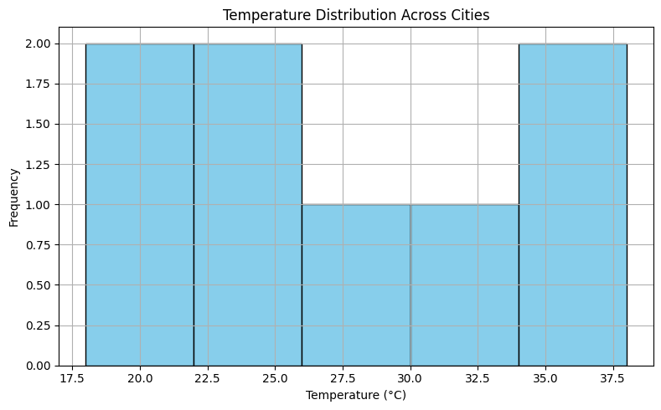
Data Visualization

Slide 5
Key Insights
Histogram – Frequency of Temperatures
Illustrates distribution of temperature values across cities.
Reveals whether the temperatures are centered, skewed, or multimodal.

Slide 6
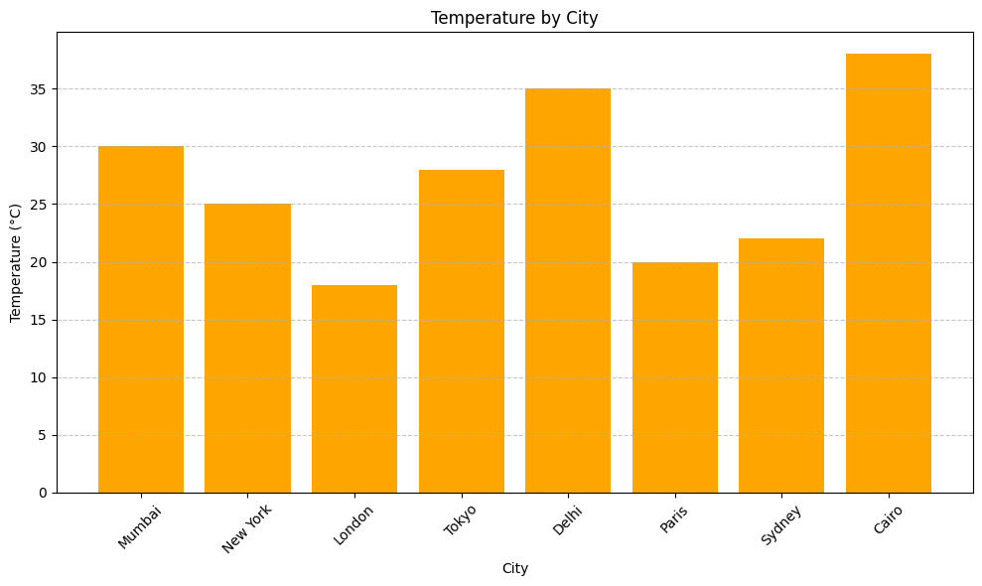
Data Visualization

Slide 7
Key Insights
Bar Plot – Plot of Temperature by City
Illustrates distribution of temperature values across cities.
Reveals whether the temperatures are centered, skewed, or multimodal.

Slide 8
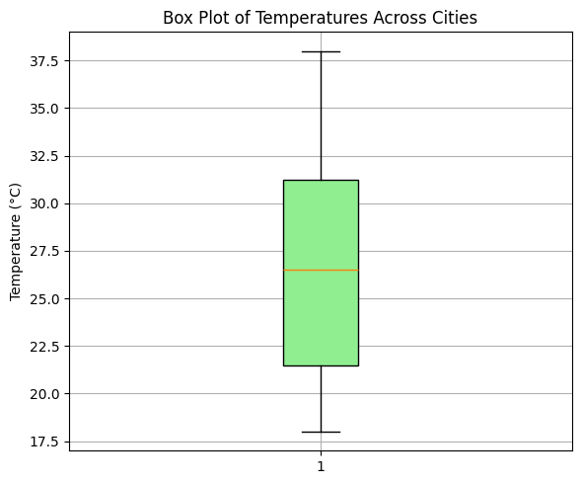
Data Visualization

Slide 9
Key Insights
Box Plot – Temperature Range Analysis
Highlights median, quartiles, and outliers.
Cities like Delhi may show high variability due to extremes.

Slide 10
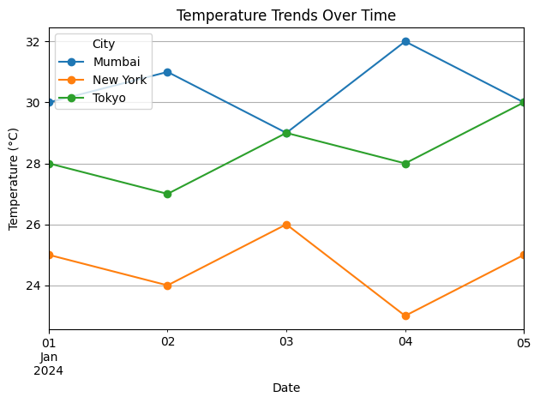
Data Visualization

Slide 11
Key Insights
Line Plot – Temperature Trend Over Time
Displays how temperature varies over 5 days for each city.
Helps detect warming/cooling trends.
Cities compared: Mumbai, Tokyo, New York.

Slide 12
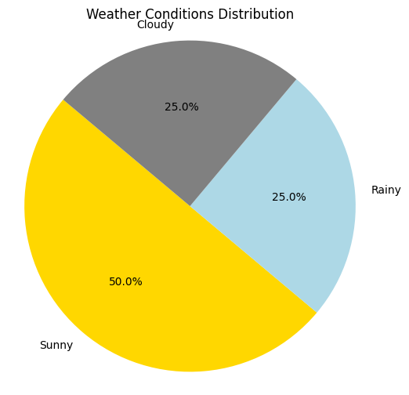
Data Visualization

Slide 13
Key Insights
Pie Chart – Weather Conditions Distribution
Quantifies proportion of Sunny, Rainy, Cloudy days.
For example: 50% Sunny, 30% Cloudy, 20% Rainy.

Slide 14
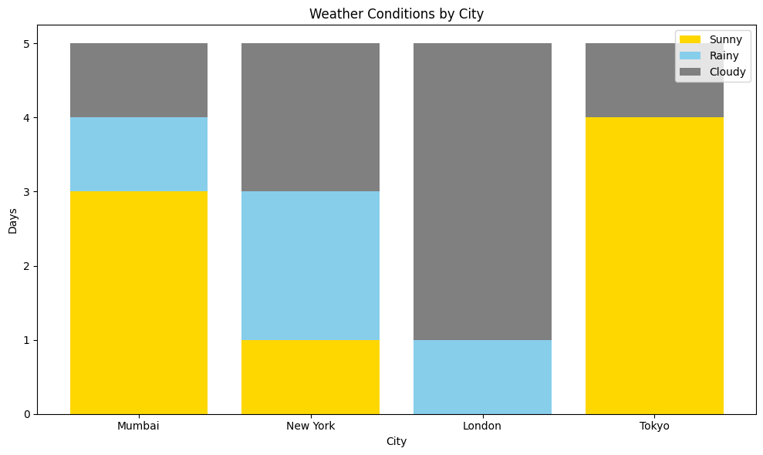
Data Visualization

Slide 15
Key Insights
Stacked Bar Chart – Weather Types by City
Each bar represents one city.
Segments show counts of Sunny, Rainy, Cloudy days stacked.
Ideal for comparing weather variability between cities.

Slide 16
Findings
Mumbai and Tokyo had more Sunny days, indicating coastal stability.
London and New York showed more Cloudy/Rainy conditions.
Delhi experienced the highest temperature variability.
Sunny weather dominates most cities during the observed period.

Slide 17
Insights & Recommendations
Cities with consistently high temperatures (like Delhi) may require better cooling infrastructure.
Cities with more rain (New York, London) might need enhanced drainage systems.
Understanding daily temperature patterns can help in energy load forecasting.

Slide 18
Technologies Used
Language: Python
Libraries: Pandas, Matplotlib, Seaborn
Platform: Jupyter Notebook / Google Colab

Slide 19
Technologies Used
Language: Python
Libraries: Pandas, Matplotlib, Seaborn
Platform: Jupyter Notebook / Google Colab

Slide 20
Deliverables
Weather dataset (CSV format)
Python scripts for data preprocessing and visualization
Visual charts: PNG/inline outputs
Report in PDF/Word format (optional)

